Slide 1
Land Record Management System Using Blockchain
Supervisor: Mr. Adnan Bashir
Co-Supervisors: Fareed ul Hassan, Ihsan Elahi Butt
Jawad Ahmed
Sharjeel Akram
Mian Muhammad Zubair

Slide 2
Agenda
Why (Problem Statement)
01
Here we will talk about the existing problems in the land management system in Pakistan.
What (Introduction)
02
Here we will talk about the introduction.
How (Approach)
03
Here we will talk about the approach, solution to the existing problem.
When (Timeline)
04
The rough timeline will be discussed here.

Slide 3
WHY?
Existing System:
Lands are registered on pages called registers.
Managed by one person called Patwari.
Digitalized System:
Centralized System:
In few areas, digital system is being introduced for land management system.
Involvement of Middleman:
They have shared database which are run by an admin and DBMS.
Once we buy the land, we must get its ownership.
For this, we must register our land in front of witness with land revenue department.

Slide 4
WHAT?
System using Blockchain:
Shared, Immutable ledger, blocks
Blocks store the information about a transaction.
Keep track of all the records of a land.
The system will be able to transfer land to other person with mutual understanding called smart contracts.
After being uploaded to a Blockchain, data cannot be altered in any way, making it nearly impossible to modify the value of information stored there.
Our goal is to improve upon the present centralized land management system using distributed and decentralized Blockchain technology.
Different blocks make a chain with previous blocks.

Slide 5
HOW?
Hyperledger Fabric:
Rather than an open, permission-less system, Fabric offers a scalable and secure platform that supports private transactions and confidential contracts.
React JS
Front-end framework
Popular, open-source community support and backed by Facebook
Node JS
Same framework for JavaScript.

Slide 6
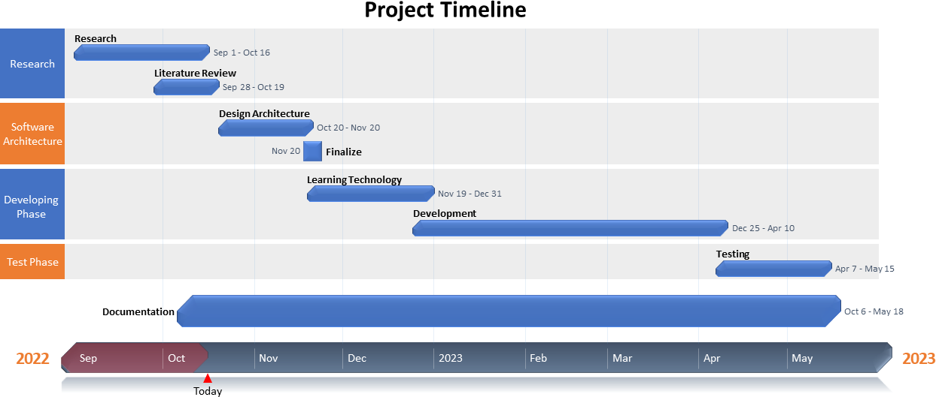
WHEN?

Slide 7

Thank You

